Slide 1
KILL THE OUTLIERS
BLG 454E Learning from Data Spring – 2020 TERM PROJECT
BRAIN CONNECTIVITY ESTIMATION

Slide 2
What is our main goal?
The goal of this project is to predict brain connectivity features at t1 from brain connectivity measured at a previous timepoint t0.
By measuring the brain connectivity at two different timepoints t0 and t1, spaced out by 6 months, we can track the changes in the brain as a network.

Slide 3

What is our main goal?
Given an elderly population, each brain is encoded in a symmetric connectivity matrix 𝐗 ∈ R35 ×35, where an element 𝐗(i, j) denotes the strength of the connectivity between two brain regions i and j.

Slide 4
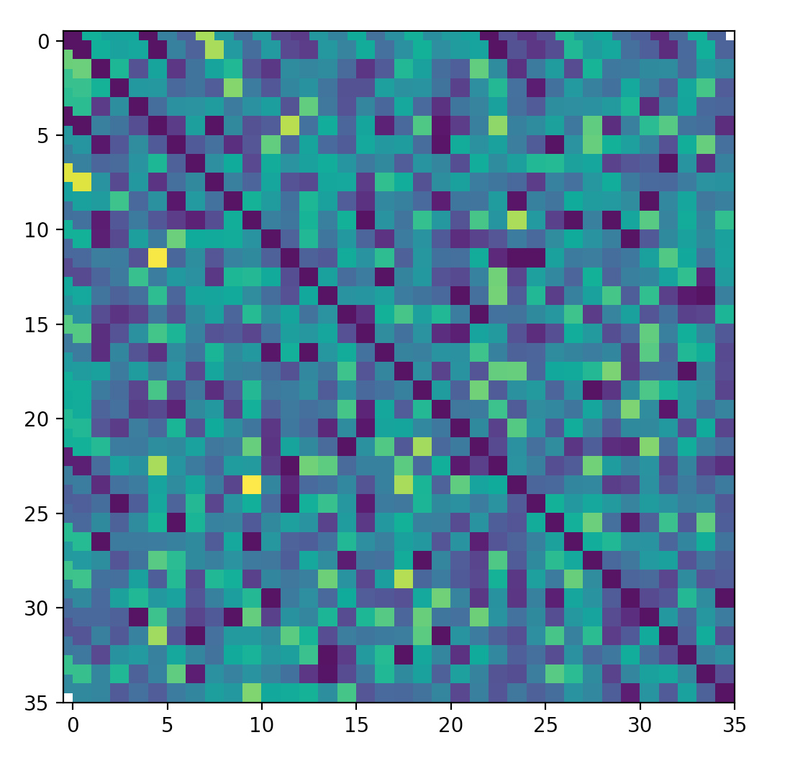
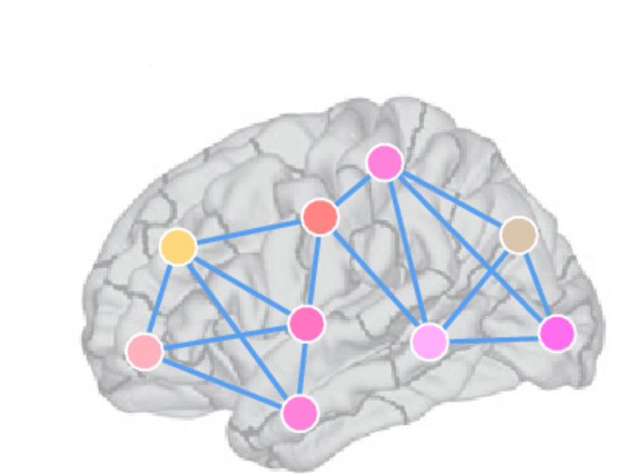
Each brain region represented by a node and every node
has a connection with other nodes. So, it creates a graph.
We can represent a graph by using adjecency matrix.
35 cortical regions of interest using Desikan-Killiany atlas (Fischl et al., 2004)

Slide 5
By vectorizing the off-diagonal upper triangular part of 𝐗, we generate a feature vector
𝐱 ∈ $R^{1∗d}$ (d = 595) representing a single sample (i.e., brain).
.
.
.
View k

Slide 6
By vectorizing the off-diagonal upper triangular part of 𝐗, we generate a feature vector
𝐱 ∈ $R^{1∗d}$ (d = 595) representing a single sample (i.e., brain).
Features
.
.
.
View k
Samples
By stacking the samples vectors vertically across N=150subjects, we construct the data matrix

Slide 7
Proposed solution
We use ;
Support Vector Regression method to fit the data
Try to normalize the data by scaling it but it did not work well
2 type of outlier reduction method:
#Remove outliers by mean method
#Remove outliers by neighbour method

Slide 8
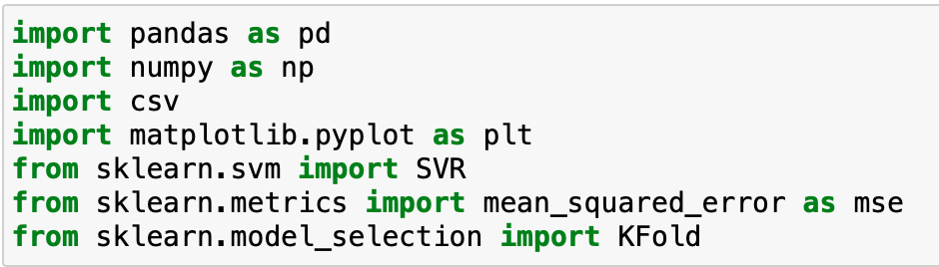
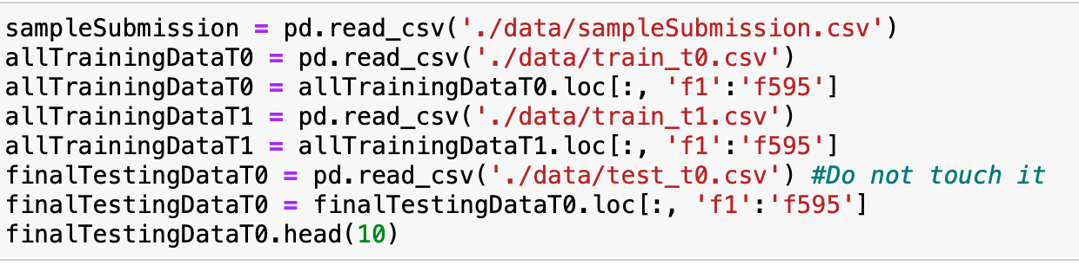
Proposed solution
We use pandas to read csv files
We use Support vector regression model
Reading the training and testing data without first column(ID).

Slide 9
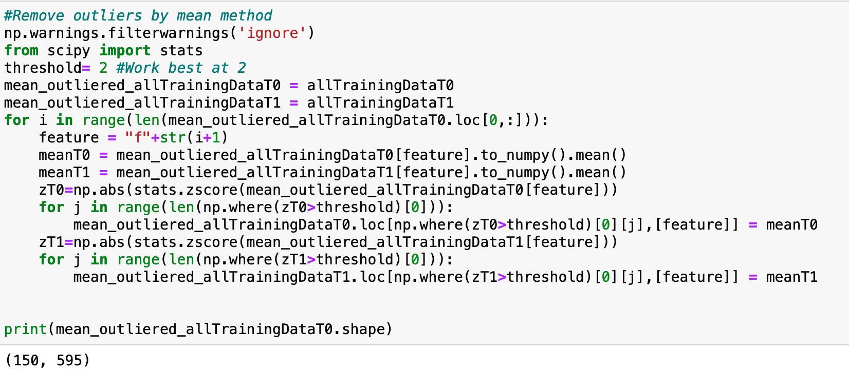
Proposed solution
1st outlier reduction method
We use scipy’s stats method to find out outliers.
For every feature, we change outlier’s values to the mean value of the feature.
After some tries, we saw that best value for z is 2.

Slide 10
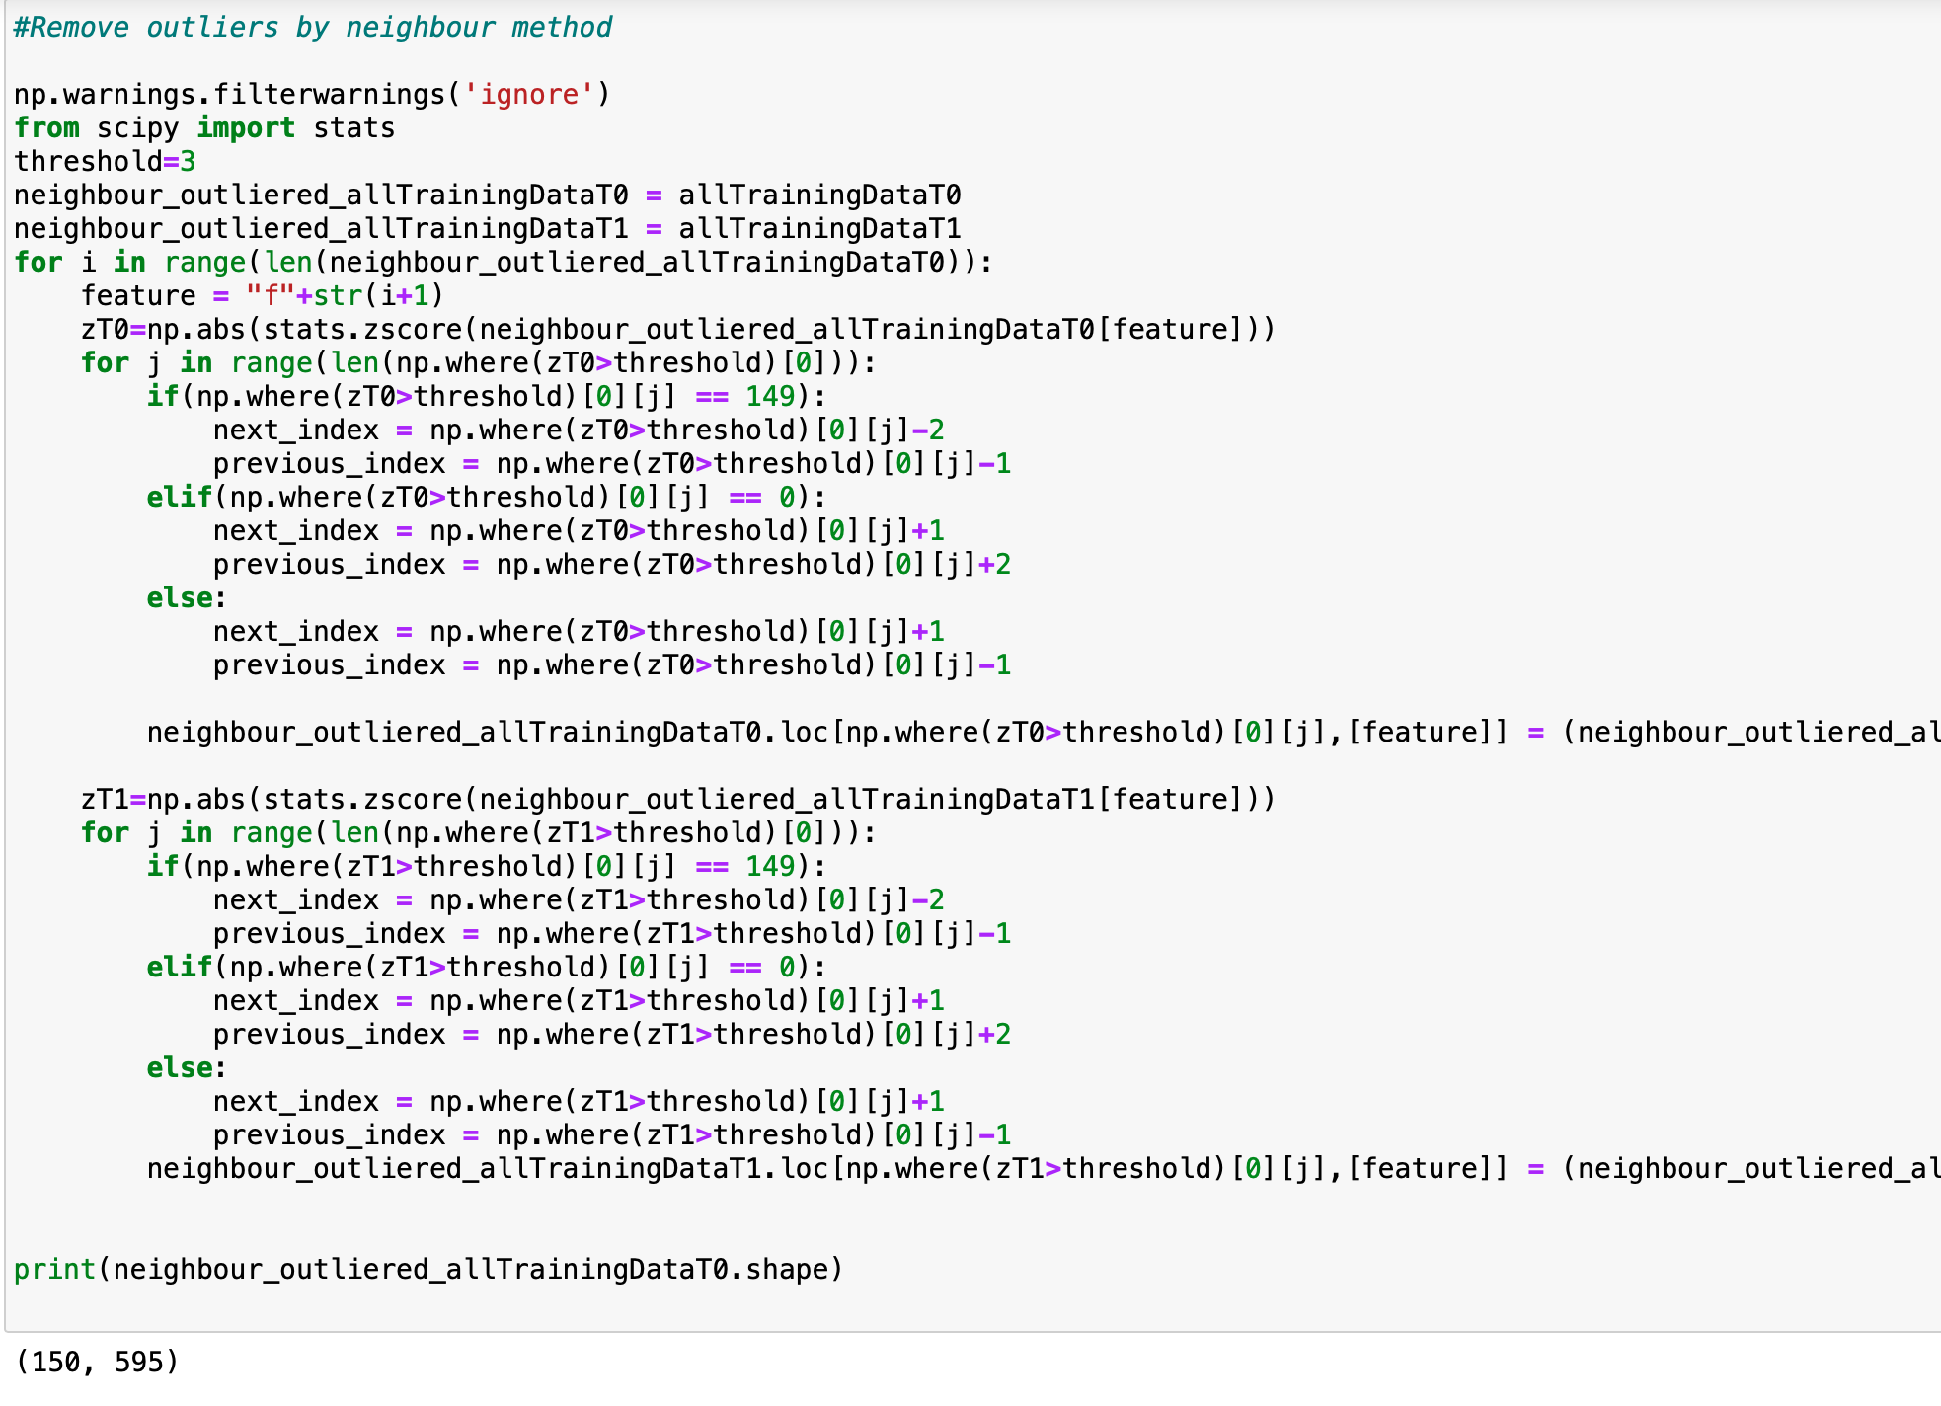
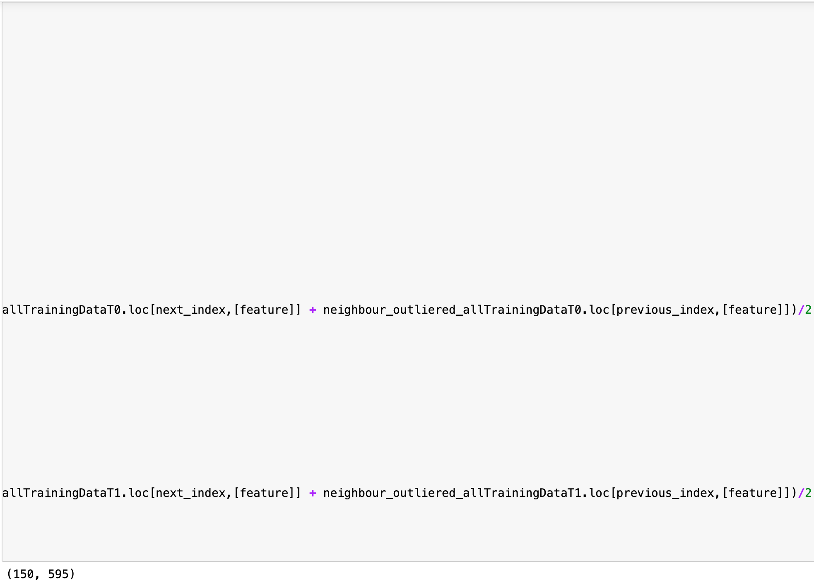
2nd outlier reduction method
We use again scipy’s stats method to find out outliers with using z value as 3 this time.
For every feature, we change outlier’s values to the mean value of the next and previous samples.

Slide 11
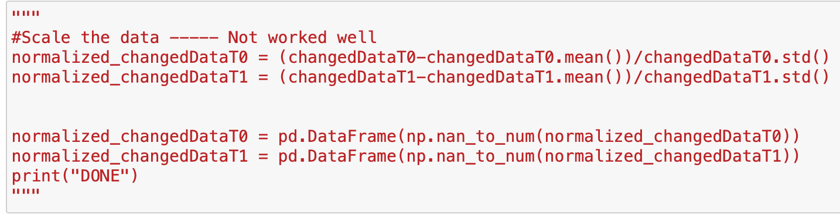
Proposed solution
We try to scale the data but the error goes UP.

Slide 12
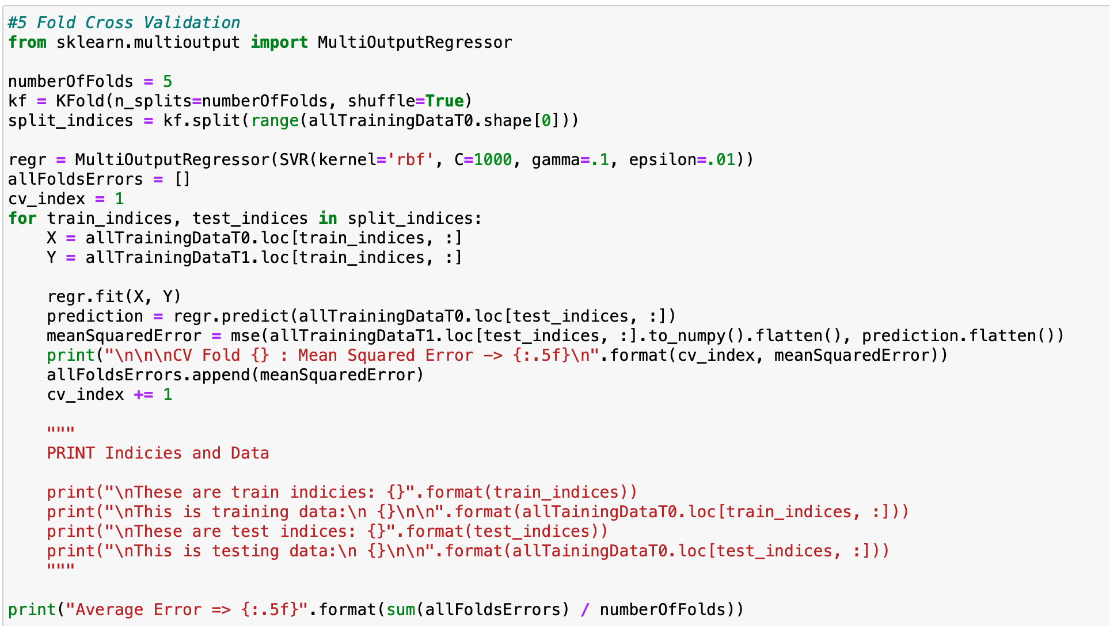
Proposed solution
First we try linear regression, then we use SVR to train the data.
We also use Sklearn’s Kfold library to create 5 fold cross validation setup.
Run the algorithm for every fold and calculate mean squared error. Finally print average error.

Slide 13
Code demo using Python and 5-fold CV

Slide 14
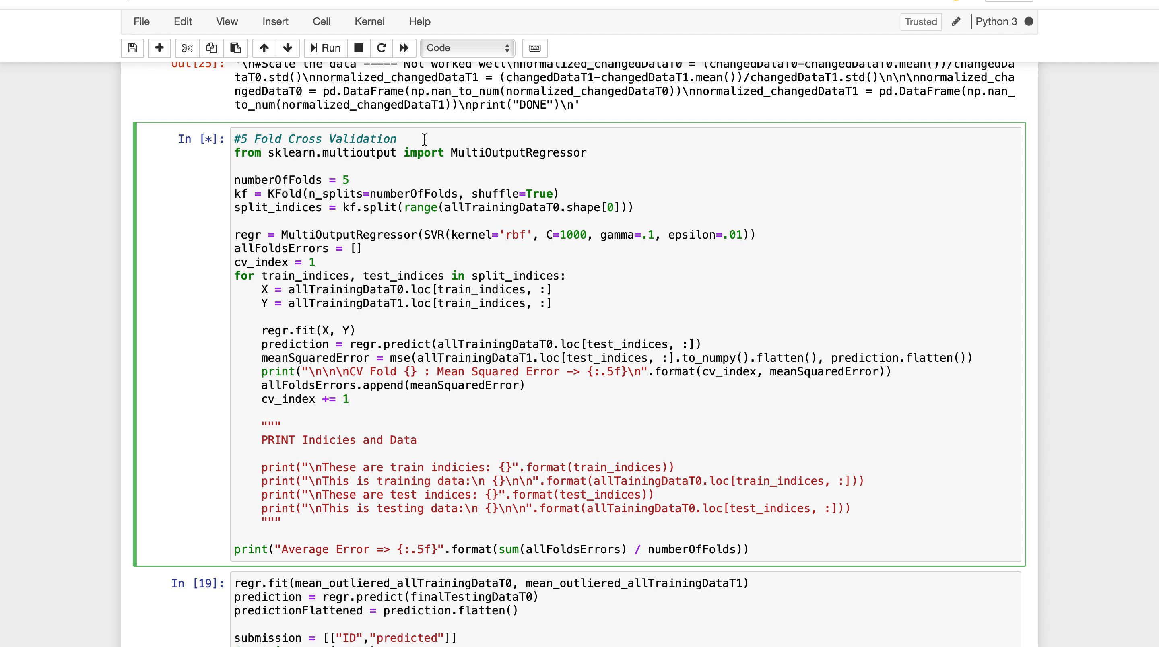

Slide 15
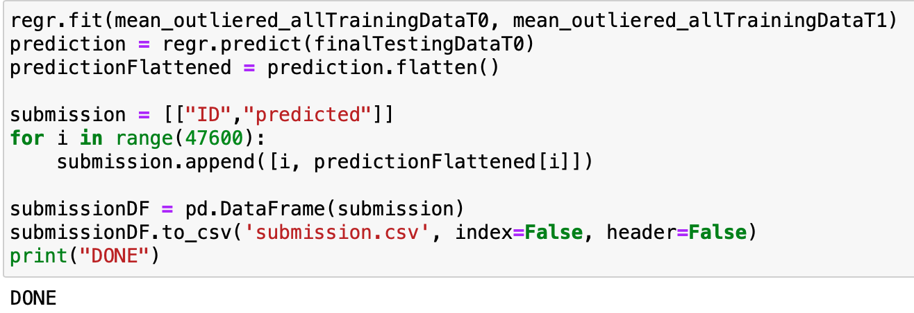
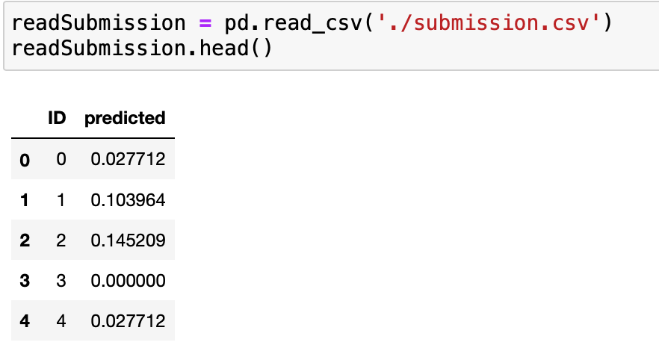
Proposed solution
Finally we train all our training data with using SVR.
Then, predict the labels of the testing data which we have
never used.
After changing it’s shape to submission format, we use
Pandas to_csv method to create submission file.

Slide 16
How to further improve our model?
Ideas to improve;
Find another way to scale the data.
Since our feature size is bigger than sample size, we could use data augmentation to create new training samples. Like we could change a photo’s shape or crop it to create new sample in deep learning, we can implement this idea to this problem.
We can use sklearn’s ensemble methods.

